Slide 1
Introduction to Evolutionary Digital Models
Randy Olson,
Arend Hintze,
and Chris Adami

Slide 2
What is Artificial Life?
Life,
as it is…
and might have been
Origin of Life
Today
Notes:
This slide: Virgil Griffith

Slide 3
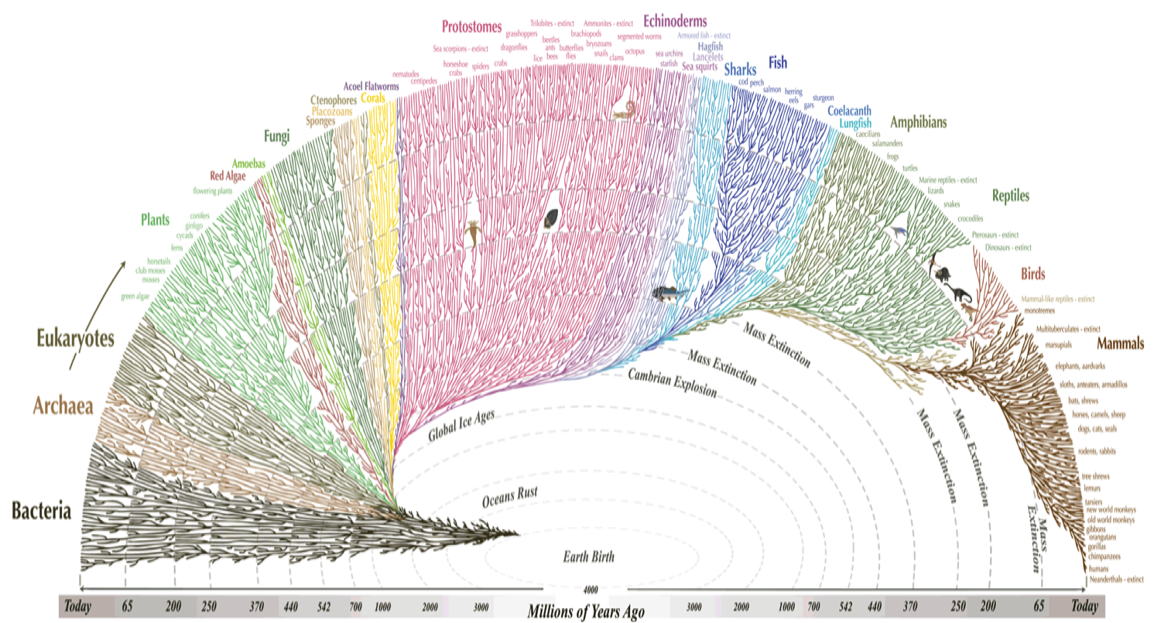
Why Artificial Life?
Evolution takes a long time
Notes:
Tree of life picture: Leonard Eisenburg

Slide 4
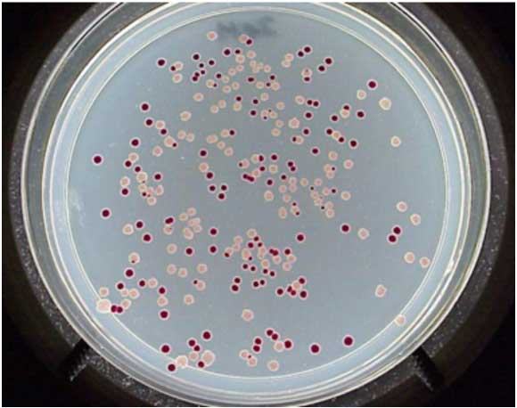
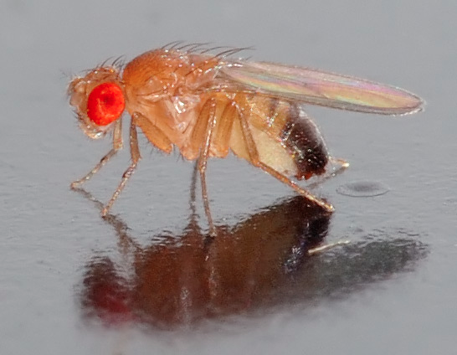
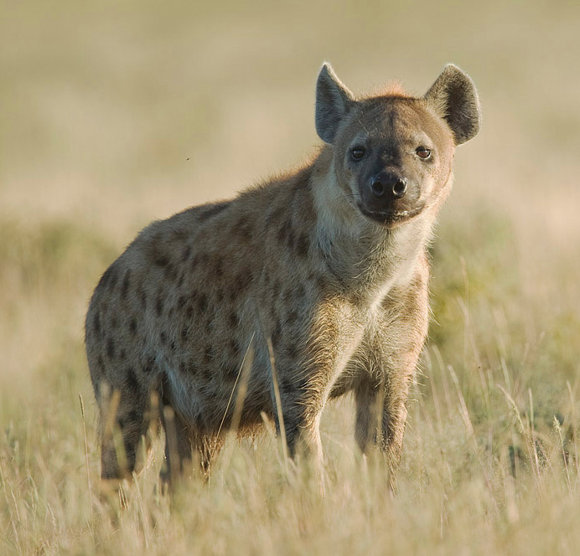
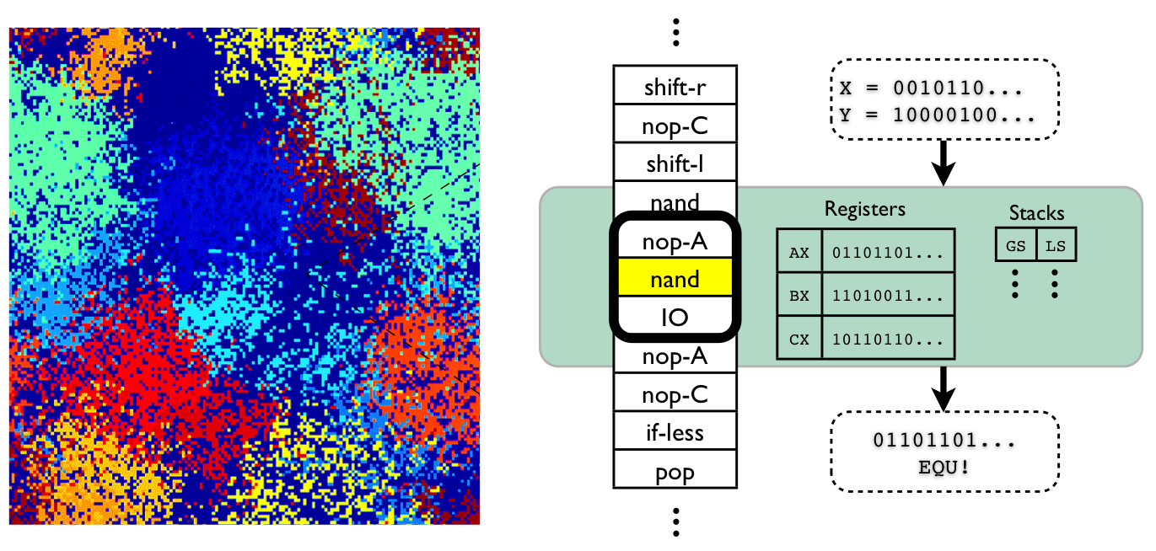
Why Artificial Life?
Evolution is universal
Notes:
Same idea as with model organisms: what we learn about the process that shapes one, we learn about the process that shapes all.
Bonus with ALife is that we aren’t limited to the organisms that exist today. We can explore any form of life.
E. coli plate picture: Rich Lenski
Drosophila picture: André Karwath
Hyena picture: Yathin S Krishnappa
Avida picture: Dave Knoester

Slide 5
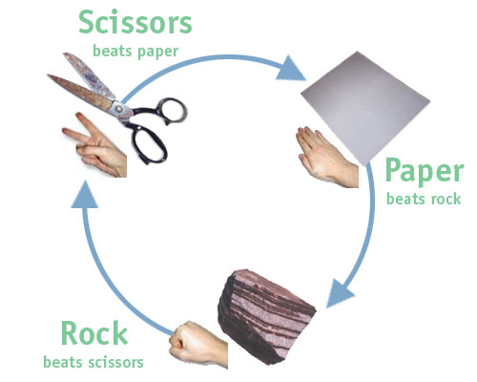

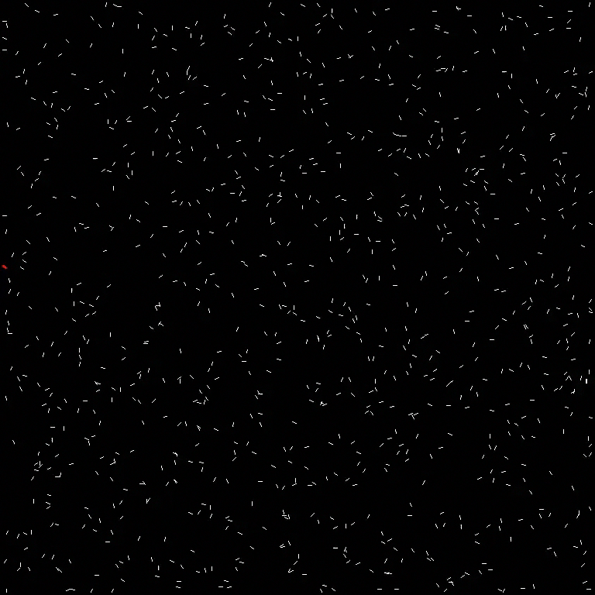

Abstractions of Artificial Life

